Slide 1
EmpowHer
EmpowHER: Empowering Girls for Corporate Excellence Soft Skill Curriculum All Things Agile

Slide 2

Agenda
Introduction to Agile and Scrum
Agile principles and values
Scrum framework and roles
Sprint planning and execution
Product backlog management
User story writing and acceptance criteria
Agile estimation and planning techniques
Agile testing and quality assurance
Continuous integration and delivery
Agile project management tools and techniques

Slide 3
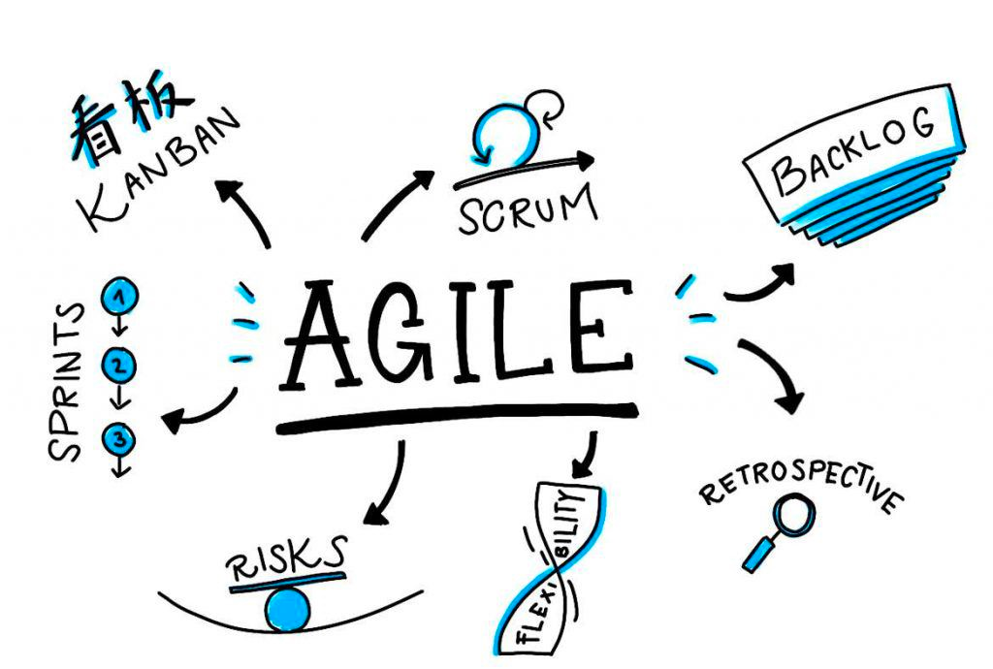
Introduction to Agile
Agile typically means responding to Change
An iterative delivery
Goal driven
Seeking feedback
Learn and improve

Slide 4
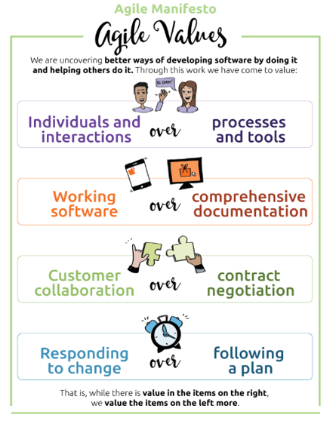
Core Agile Values
Four Agile Values
Four Agile Values
Source: @AgileManifesto.Org

Slide 5
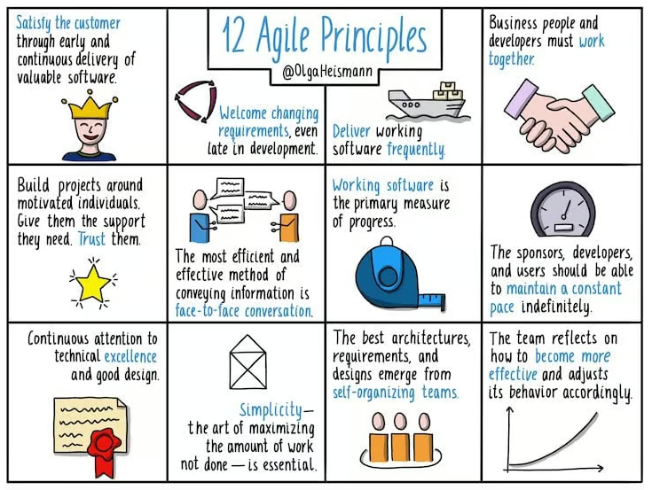
Agile Principles
Twelve Agile Principles
Source: @OlgaHeismann

Slide 6
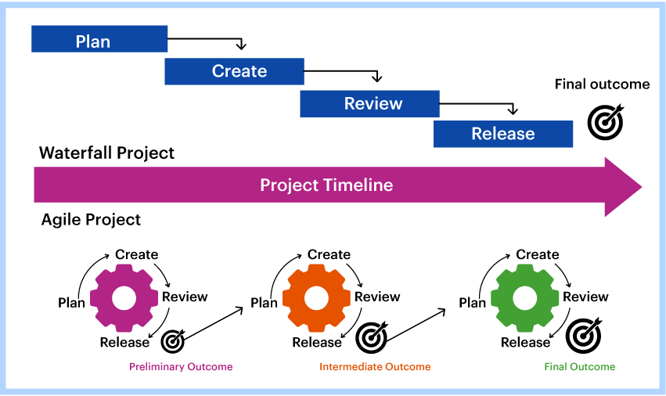
Methodologies and Frameworks
Methodologies
Waterfall
Agile
Extreme Programming (XP)
Spiral
Lean
Frameworks
Scrum
Kanban
Feature Driven Development (FDD)
SAFe
Disciplined Agile (DA)

Slide 7
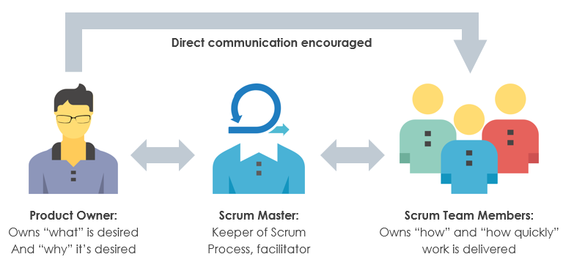
Scrum Team and Roles
The Scrum Team is a group of individuals coming together to work towards a common goal.
Scrum roles –
Product Owner
Scrum Master
Development Team
Traits of dev team -
Self Organizing
Cross Functional

Slide 8
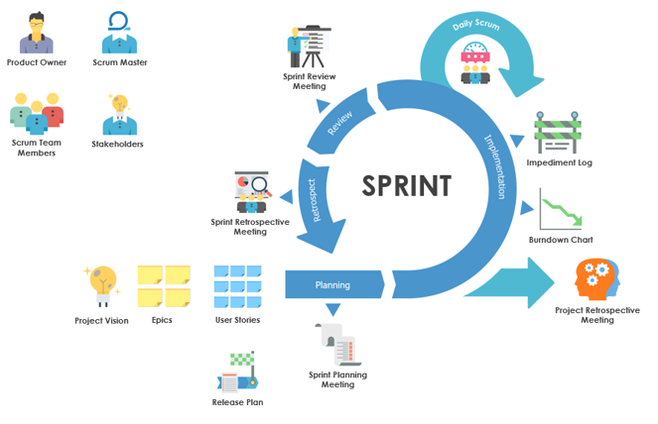

Scrum Framework and Sprints
The Scrum framework is a lightweight, iterative approach to software development.
It organizes work into small, manageable pieces called ‘Sprints', typically lasting 2-4 weeks. Within these sprints, cross-functional teams work on selected items from a prioritized list of tasks, aiming to deliver working software.
Scrum emphasizes collaboration, flexibility, and transparency among team members

Slide 9
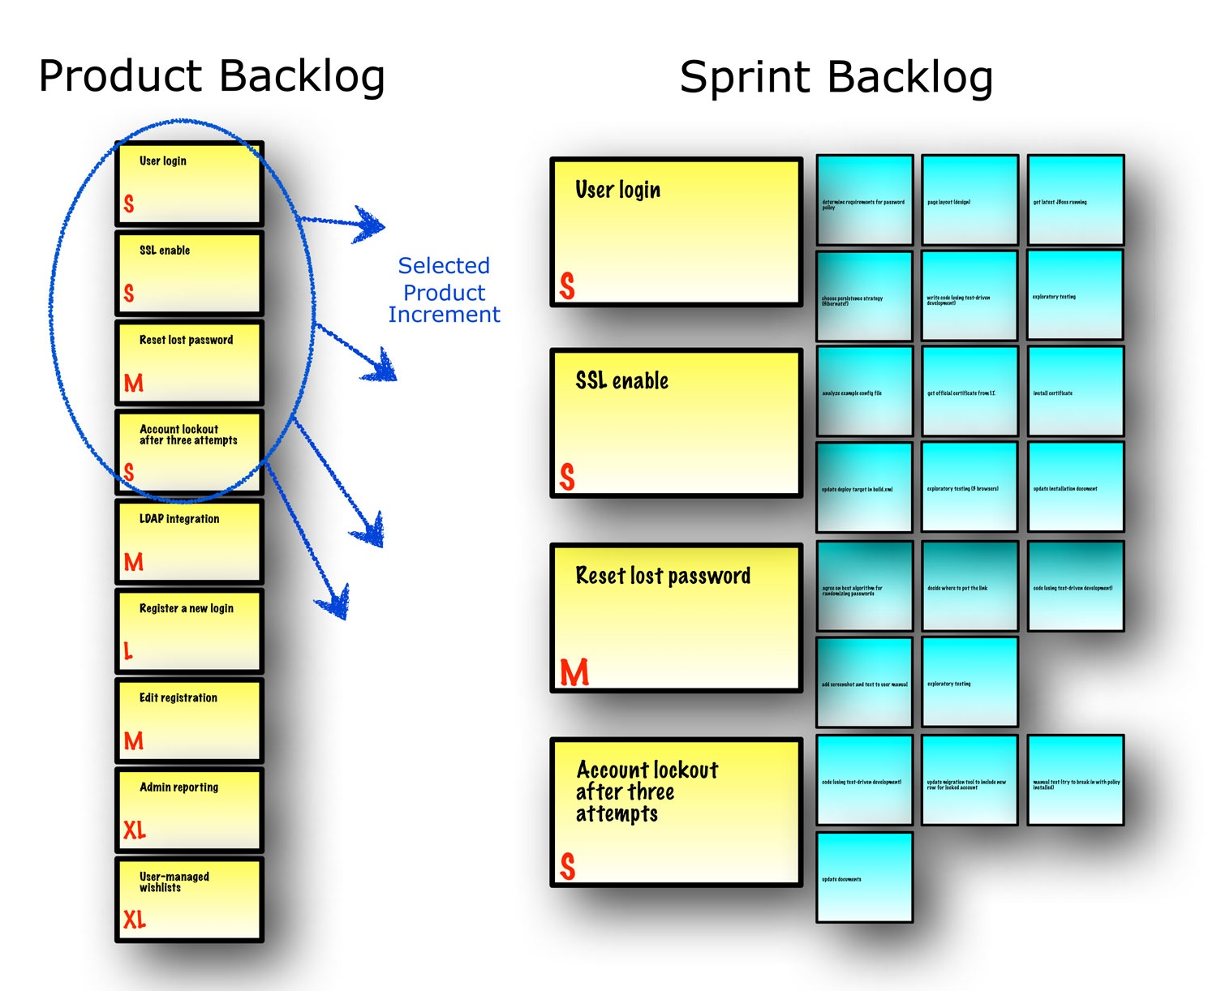
Sprint Planning and Execution
Input
Product Backlog
Increment
Velocity
Capacity
Definition of Done
Improvement Items from Previous Sprint
Output
Sprint Goal
Sprint Backlog

Slide 10
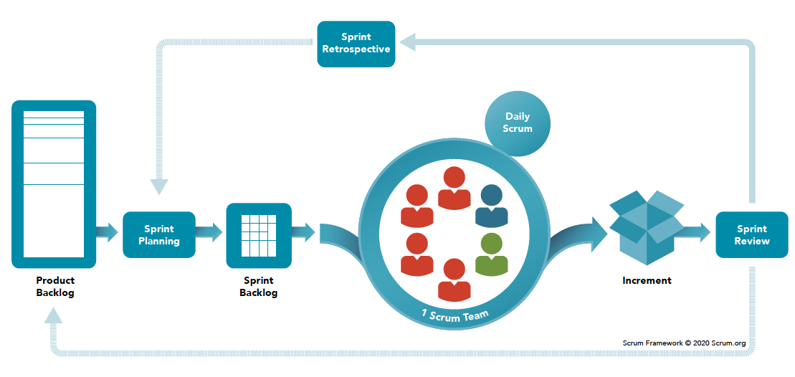
Scrum Ceremonies
Input
Sprint Planning
Daily Stand-ups
Sprint review
Retrospective
Backlog grooming/refinement
Backlog Grooming

Slide 11
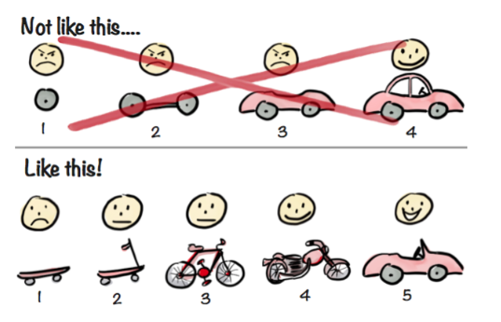
Minimum viable product
A minimum viable product is a version of a product with just enough features to be usable by early customers who can then provide feedback for future product development.

Slide 12
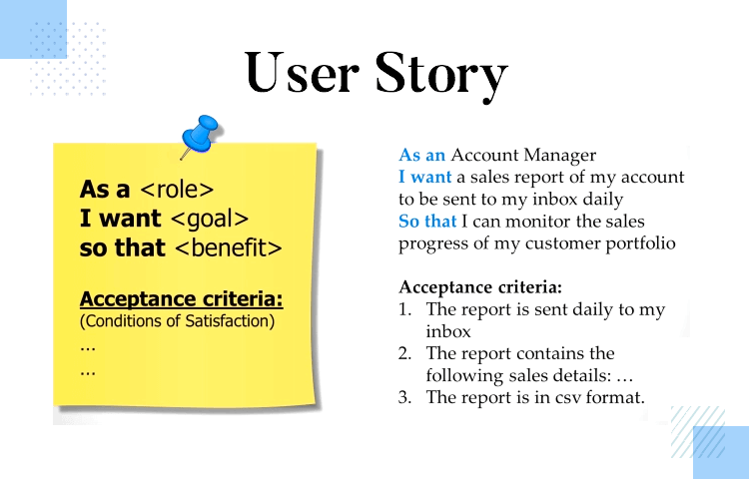
User Stories
Story - A user story is a smallest unit of work in Agile methodology, describing the desired functionality from an end user's perspective
Story Template:
“As a (intended user),
I want to (intended action),
so that (goal/outcome of action).”
Acceptance Criteria: AC for a story is the set of conditions that a specific feature or function must meet in order for the user to accept the functionality.
AC Template:
“Scenario: (explain scenario).
Given (how things begin),
when (action taken),
then (outcome of taking action)

Slide 13
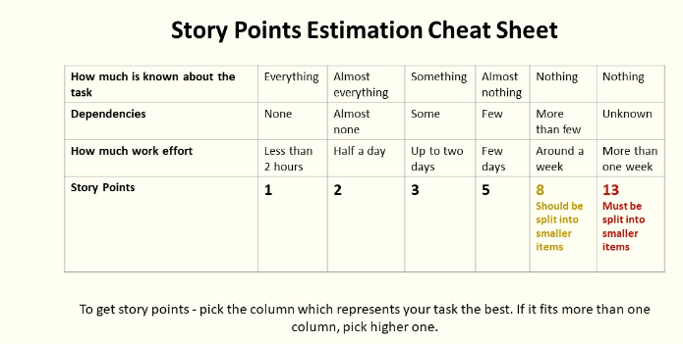
Agile Estimations
Popular Estimation Techniques
Planning Poker
T-shirt sizing
Three points estimation
Bucket System
Affinity Estimation
MoSCoW method – Help with prioritization

Slide 14
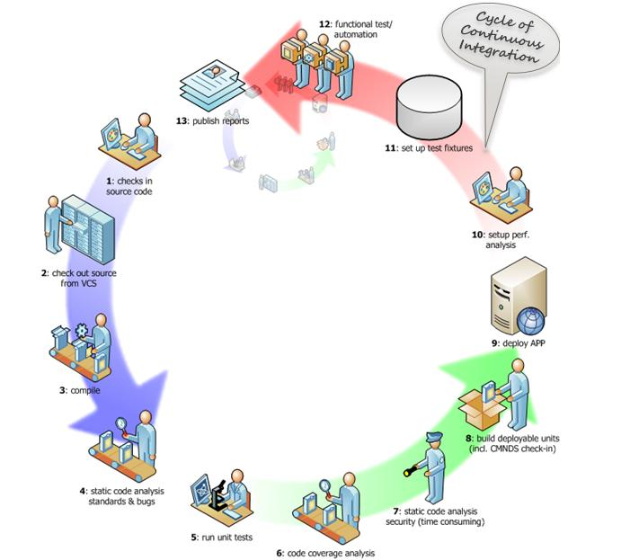
Continuous Integration, Continuous Delivery
Continuous integration: CI is an agile and DevOps best practice of routinely integrating code changes into the main branch of a repository, and testing the changes, as early and often as possible.
Continuous Delivery: CD enables frequent, systematic, and repeatable software releases. Extending agile software development with continuous delivery provides several benefits, including faster time-to-market, more accurate product builds, enhanced productivity, code reliability, and customer satisfaction.

Slide 15
Questions and Answers
Vikram Singh Shekhawat

